Slide 1
HARNESSING THE SUN - IS A SOLAR SYSTEM WORTH IT?
Boris Serebrinskiy, Morgan Stanley
Data Science Class, General Assembly

Slide 2
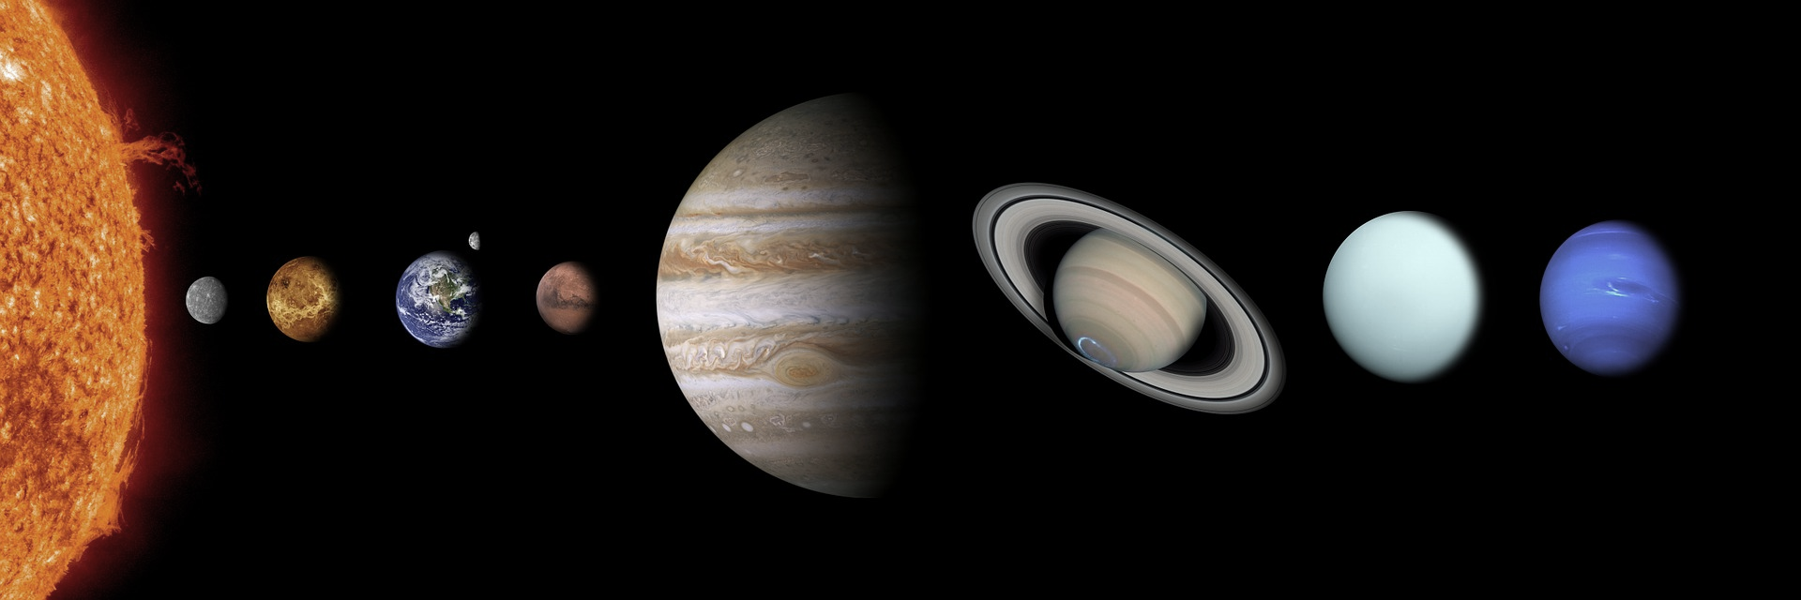
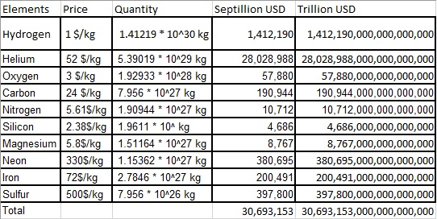
ARE SOLAR SYSTEMS EXPENSIVE ?
Asking the right questions is critical!
Wrong question – wrong answer: “How much is the Sun worth?” – the present value of the Sun is 30 x 10³⁰ US dollars (according to Quora) , most of it is Helium, by the way.

Slide 3



IS THE SUN WORTH IT ?
The context is even more important!
Wrong context – wrong answer: “How much does “The Sun” cost?”
– “The Sun is raising its cover price by 10c on Saturdays and by 20c on Sundays”

Slide 4
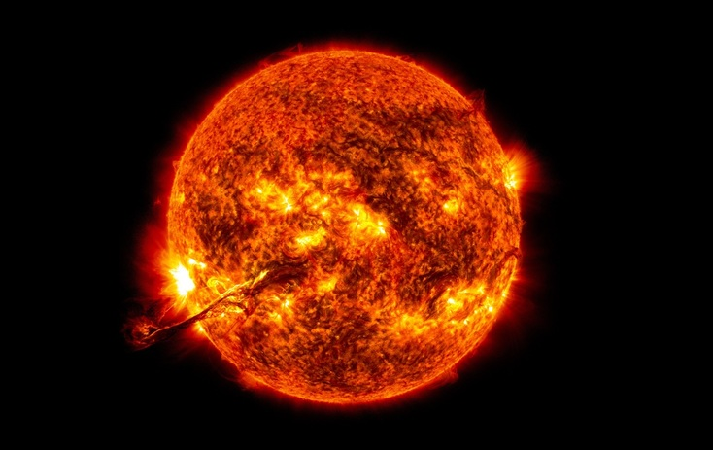
IS THE SOLAR ENERGY WORTH IT?
More specific questions yield more specific answers but they need to be relevant!
Irrelevant question – irrelevant answer:
Our sun produces out about 3.8x10²⁶ joules of energy. On an average, electricity per KWh costs about 10 to 15 cents. Within just an hour, our sun can produce electricity worth of 500,000,000,000 trillion dollars (500 trillion trillion).
(https://www.scrivial.com/)

Slide 5
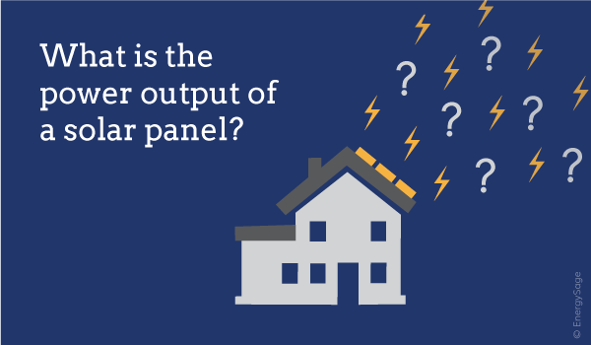
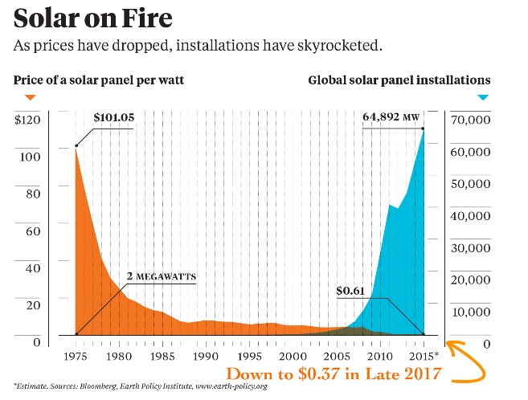

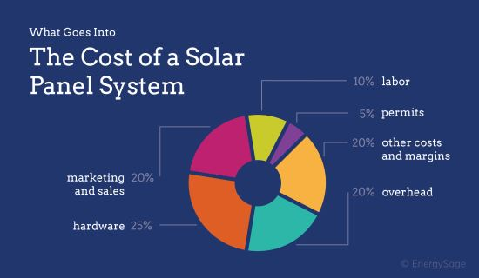
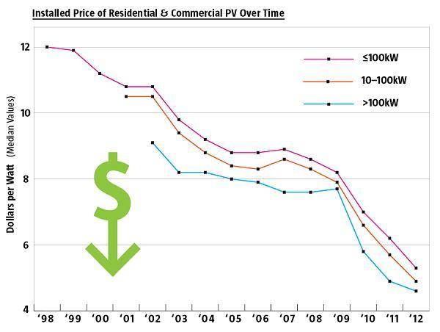
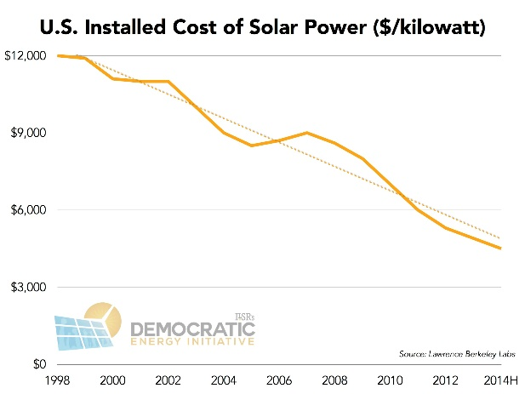
HOW MUCH WILL I PAY FOR A SOLAR POWER SYSTEM ? WHAT WILL BE MY RETURN ON INVESTMENT ?
Relevant, specific, measurable, and the most important – can be predicted!

Slide 6
TOP 5 REASONS TO GET SOLAR
Reason #1: If you have solar it means you have a home and a stable income.
If you’ve got solar, she knows you not only have a house, but a premium house and that you’re actually employed. Always a good start.
Reason #2: A guy who has solar is a guy who’s thinking about the future.
If you’ve got solar, you’re telling her that you care about the environment and the future of your children and grandchildren.
Reason #3: Having solar means that you’re a smart investor.
If you’ve got solar that may indicate to her that you’re a person who’s smart with money and can plan for retirement.
Reason #4: A guy who has solar means you can explain things and communicate.
Solar always leads to questions. How much does it cost? Does it need batteries? How long do they last? If you can coherently explain solar, then 1) you come off smart, and 2) she may be thinking that you’ll be able to explain other complicated things in your marriage…like why were you late coming home and who you were texting at 3 am last night.
Reason #5: A guy who has solar means he can commit.
Just like marriage, solar is a long term commitment. This indicates that you can commit to a long term relationship with solar panels, so perhaps you two will last longer too.

Slide 7
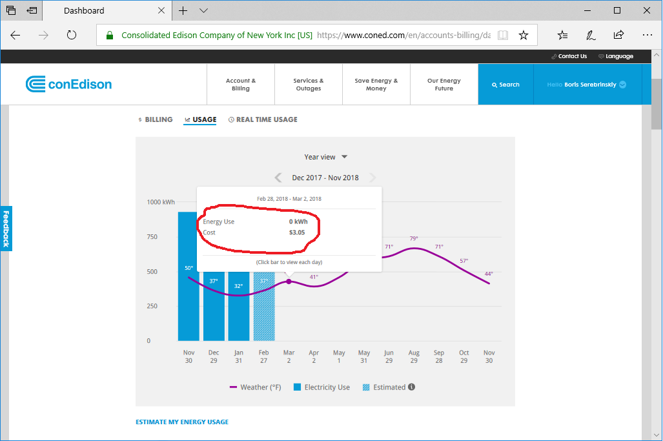
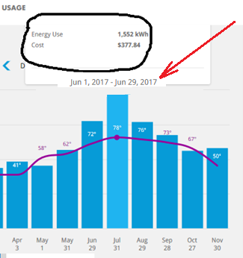
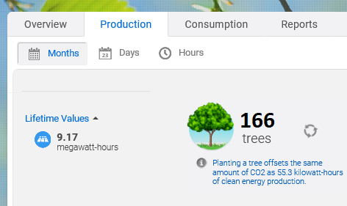
SERIOUSLY, WHAT’S IN IT FOR ME?
NERO ZERO BILLS AND REAL IMPACT on the environment

Slide 8
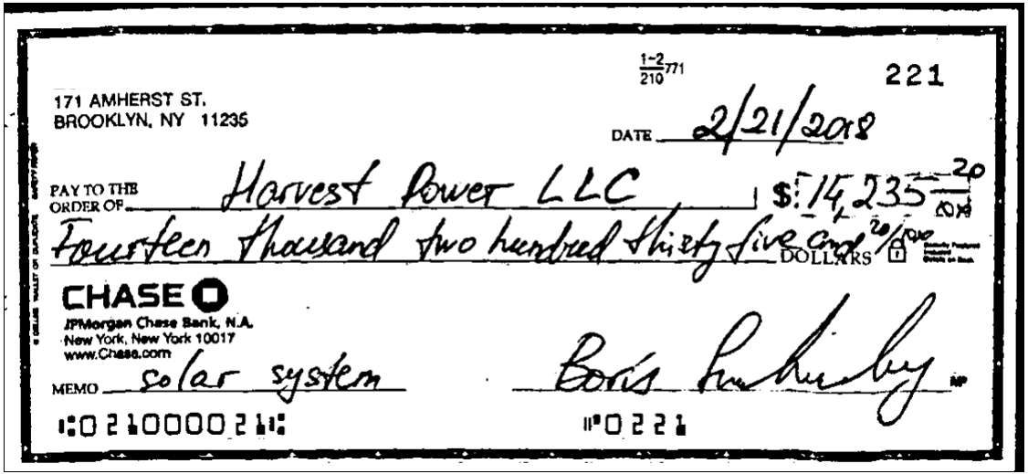
BUT… WAS IT A GOOD DEAL, DID I PAY TOO MUCH? WHAT DO OTHER PEOPLE PAY? WHAT IF I HAD WAITED?

Slide 9
Plan of attack
What am I trying to learn?
What are my assumptions and hypothesis?
What is important to know?
What data do I need?
What models will I use?
What will be my conclusions?

Slide 10
Assumptions and hypothesis
Solar power becoming more widespread and more affordable
Panel technology improves every year
Federal, state and city government provide tax incentives
Electricity rates are rising, making solar energy more appealing
People are becoming more environment conscious
But:
The labor and constructions costs are raising
Government policies are difficult to predict - some states are actively supporting renewable energy while others make no efforts to promote it.
In some places (Florida) there is an active State resistance to the solar power.
Problem Statement: What are the effects of technological progress and economical factors on costs of solar energy systems?
Hypothesis: Solar energy costs will continue to decrease. They primarily depend on efficiency of the solar panels, size of the systems, and economic incentives.

Slide 11
GATHERING DATA
Obvious choice – find what other people paid – Berkley Lab - https://emp.lbl.gov/tracking-the-sun/ - 2 million solar power systems since 2000
What do people pay for electricity– U.S. Energy Information Administration https://www.eia.gov/electricity/data/state/
How much solar energy do they get - National Solar Radiation Database https://nsrdb.nrel.gov/
How much does it cost to build an average house – U.S. Cencus construction price index https://www.census.gov/construction/cpi/
Is your state friendly to solar – state legislature partisan composition http://www.ncsl.org/research/about-state-legislatures/partisan-composition.aspx
Electric vehicles stats https://www.afdc.energy.gov/data/ http://evadoption.com/ev-market-share/ev-market-share-state/
Totally crazy stuff: Microsoft BING Mapping API https://msdn.microsoft.com/en-us/library/dd877180.aspx

Slide 12
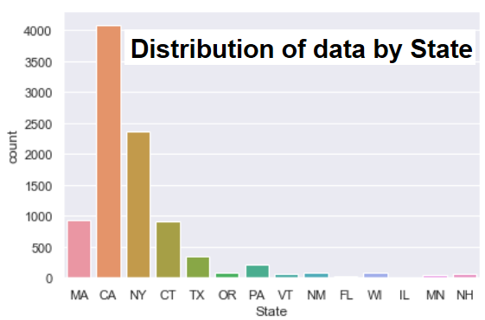
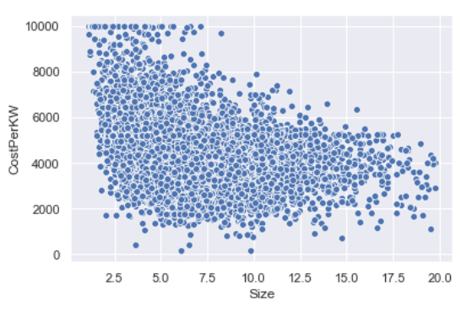
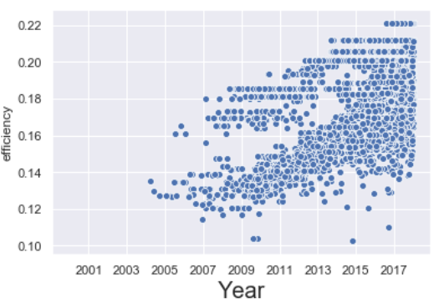
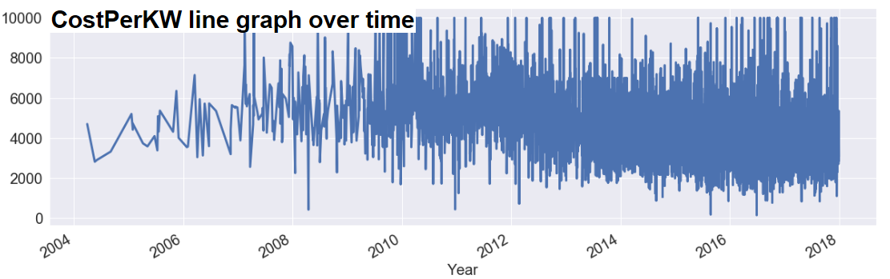
CLEANING AND EXPLORING DATA. PART I
Berkley data had too many empty columns and too many rows – I took random set of 20,000
I dropped non-residential systems and anything that was too large to be one (>100k USD)
I removed any data without solar panel efficiency or rebate/tax information
Added CostPerKilowatt, IncentivePercentage, and CleanPrice (cost after incentives) features
I ended up with about 9000 observations

Slide 13
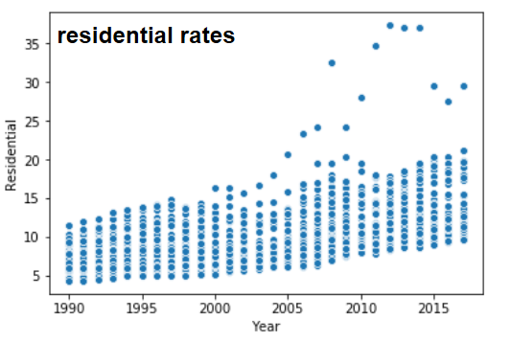
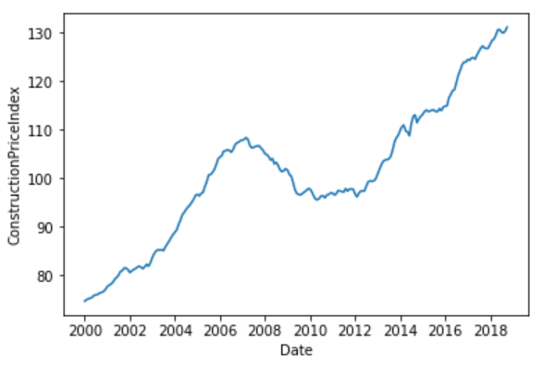
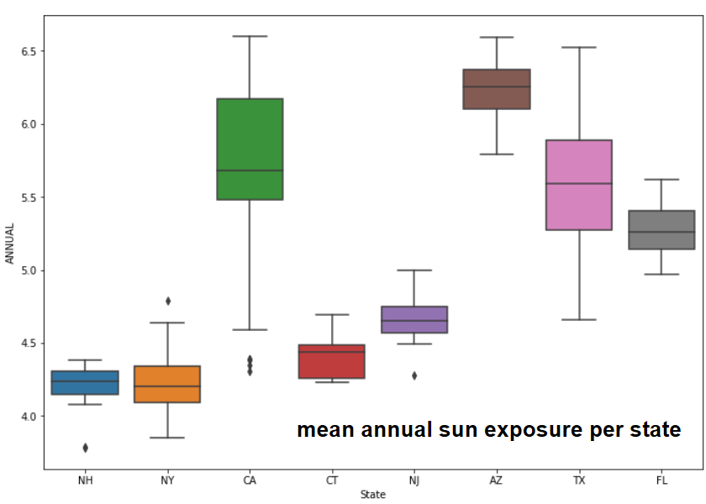
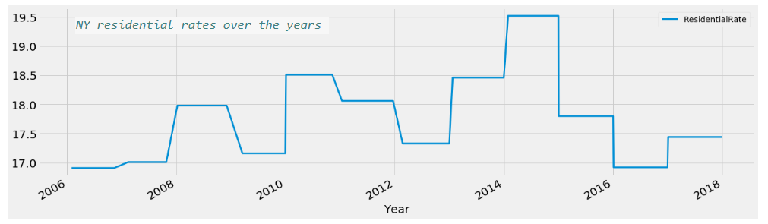
CLEANING AND EXPLORING DATA. PART II
Added residential electricity rates by joining on State and Year
Joined with construction costs from U.S. Census data normalized to 2005 prices as “100”
Decided to join with NASA solar data BUT it had no Zip or State, just the GPS coordinates!!!
Derived State and Zip using Bing Map API and GPS coordinates (my house test below)
response = requests.get("http://dev.virtualearth.net/REST/v1/Locations/40.661000,-73.963000?o=json&key=AmIRhNMzTSnkHgcyEbKzgOYPeHT9G4r1I4ruInftcdWcnPhPeJiJ4y79MZ5IaVfX")
Added Return On Investment in Years feature – an approximation of costs vs power generated

Slide 14
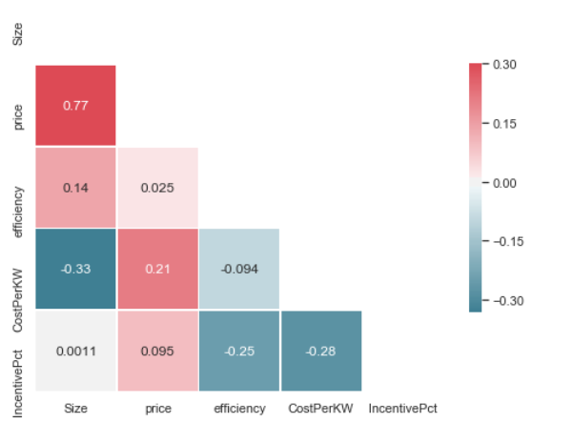
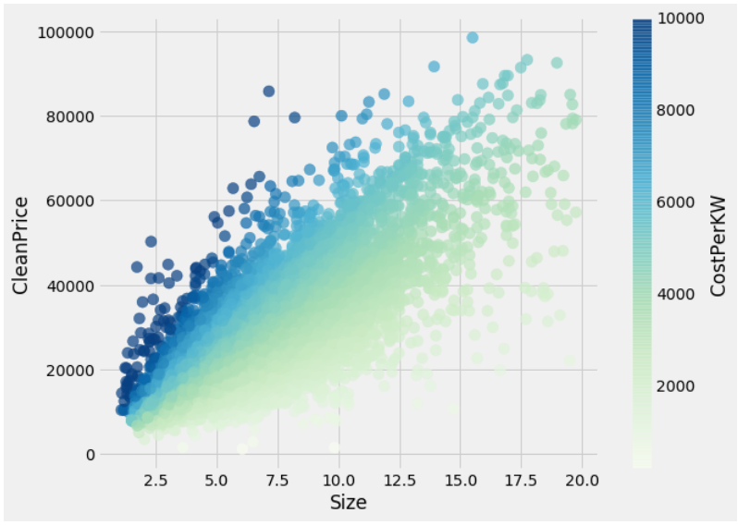
EXPLORING DATA - CONCLUSION
Efficiency rises over time, there is a clear upward trend
CostPerKW is negatively correlated with IncentivePct (more incentive means less costly installations)
Efficiency is somewhat correlated with CostPerKW (higher efficiency means fewer panels needed)
Size is also negatively correlated with CostPerKW
Higher incentive percentage lowers CostPerKW, so does a larger system size

Slide 15
MODELING - Variables
Target variable: CleanPrice, CostPerKW or ROIYears. We will model prediction of CleanPrice only
Prediction metrics - Efficiency, Size, Incentive Percent, Residential Electric Rate, Construction Price
Time Series (date/Year) dimension of the data
I did not explore geographical aspects of the data (State, Zip)
Data DICTIONARY | TYPE | DESCRIPTION
Size | Numeric | Size of the system in Kilowatts
CleanPrice | Numeric | Price paid by homeowner after rebates
Efficiency | Numeric | Solar panel efficiency – energy conversion %
IncentivePct | Numeric | % of rebates vs full price of installation
Year | Date | Year of the installation
ResidentialRate | Numeric | Local cost of electricity
ConstructionPriceIndex | Numeric | Cost index of an average single family house
ROIYears | Numeric | Return on Investment, years

Slide 16
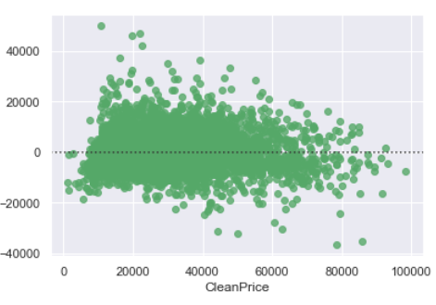
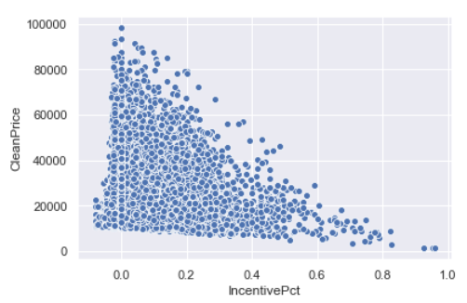
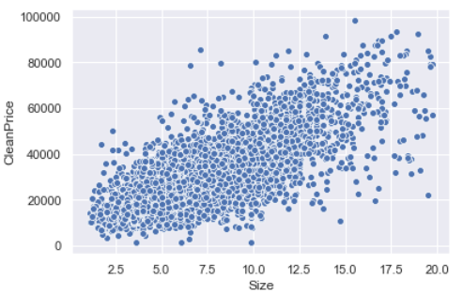
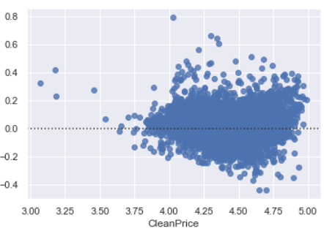
MODELING – PART I – linear regression
Correlation analysis shows two strongest variables: Size (0.76), Incentive % (-0.19) affecting CleanPrice.
I split data into modeling (8307) and holdout (1000) data sets
I ran linear regression model with cross validation on the modeling set, using train/test split, and KFolds
Resulting r2 score of 0.69. I then ran again using log10 and arrived to r2 of 0.66
RMSE 7,370
R2 0.685

Slide 17
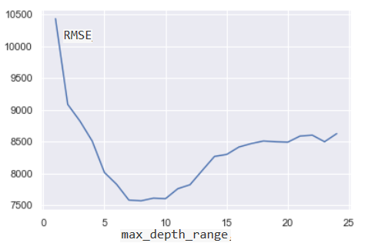
MODELING – PART II – decision Trees
I then switched to DecisionTreeRegressor using GridSearch with Cross Validation
DTR best parameter for tree depth identified as 9
I verified the fit on the holdout set and obtained RMSE of 4,755 with R2 of 0.70
Decision Tree model emphasizes strengths of Size variable over all others, forcing DT to split on that feature.
RandomForestRegressor may allow other variables a chance to affect the model, particularly “Efficiency”
RMSE 4,755
R2 0.70
feature | importance
Size | 0.634519
IncentivePct | 0.178698
ConstructionPriceIndex | 0.082567
efficiency | 0.066965
ResidentialRate | 0.037250

Slide 18
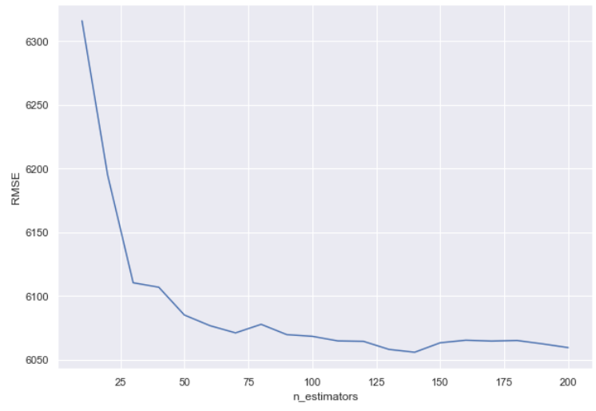
MODELING – PART III – random Forests
Using Random Forest Regressor, I identified # of estimators and # of max_features
The RFR model again emphasized importance of Size and IncentivePct, but raised Efficiency to #3 spot
I verified the fit using hold out set and obtained RMSE of 5,532 with out-of-bag R2 of 0.84
Using only NY State data, the model yields R2 of 0.9466 and RMSE of 3,110.
Using only 2017 data for all states, the model yields R2 of 0.93 and RMSE of 3,228
RMSE 5,532
R2 0.84
feature | importance
Size | 0.644747
IncentivePct | 0.152315
efficiency | 0.076981
ConstructionPriceIndex | 0.074896
ResidentialRate | 0.051061

Slide 19
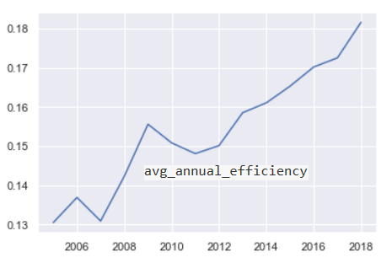
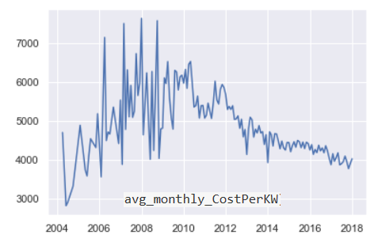
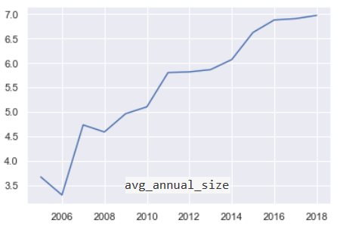
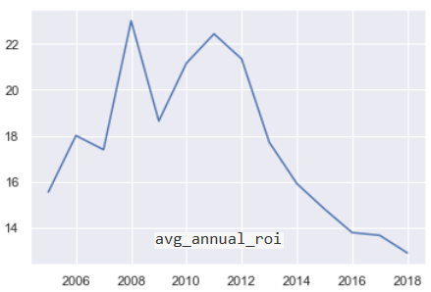
BASIC TREND ANALYSIS
I did only a basic analysis of time series trends, further analysis is needed. Here are basic visuals.

Slide 20
MODELING - CONCLUSION
Conclusion - we have attempted to use simple linear regression, decision tree and random tree regressor models. The latter provided us with the best R2 of 0.84 and performed even better on NY State (0.94) and 2017 data (0.93) separately.
We have identified strongest features affecting the outcome (CleanPrice target variable) – with Size, IncentivePct, Efficiency, ConstructionPriceIndex, ResidentialRate, in descending order of importance.
We did not directly use Solar Radiation rates but attempted to include it into ROIYears variable, this would require further analysis.
We did not directly address time series aspect of the data or the geographical dependencies
We did not directly use data about state legislature composition but instead focused on Incentive Percentage. But what affects that Percentage itself?

Slide 21
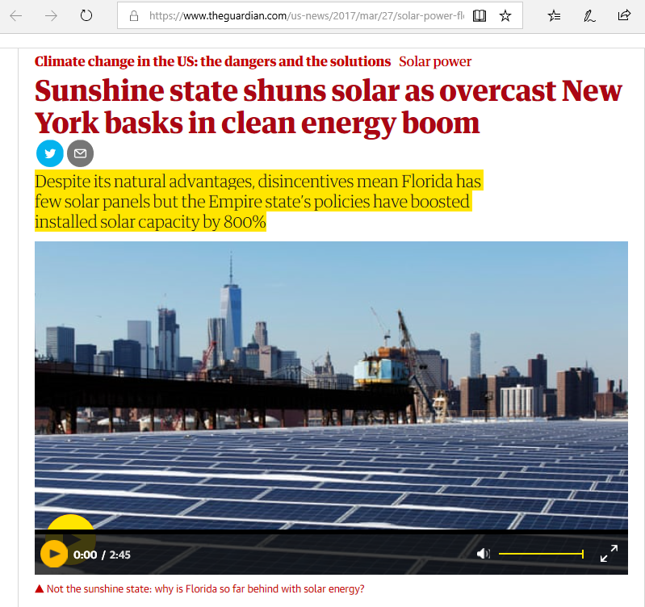
POLICY MATTERS!

Slide 22
POLICY MATTERS!
New York Solar
New York has consistently been in the top 10 US solar markets. The state has policies in place to promote solar investment, including net metering.
Percentage of State's Electricity from Solar: 1.33%.
New Jersey Solar
New Jersey has been an early leader in solar. The New Jersey Solar market continues to see strong growth.
Percentage of State's Electricity from Solar: 3.98%.
Massachusetts Solar
The Massachusetts market is shaped by net metering. The Solar Massachusetts acts as a template for other states to follow.
Percentage of State's Electricity from Solar: 9.80%.
Florida Solar
Percentage of State's Electricity from Solar: 1.07%.
Louisiana Solar
Percentage of State's Electricity from Solar: .12%.
Mississippi Solar…. 0.51%
Enough said….

Slide 23
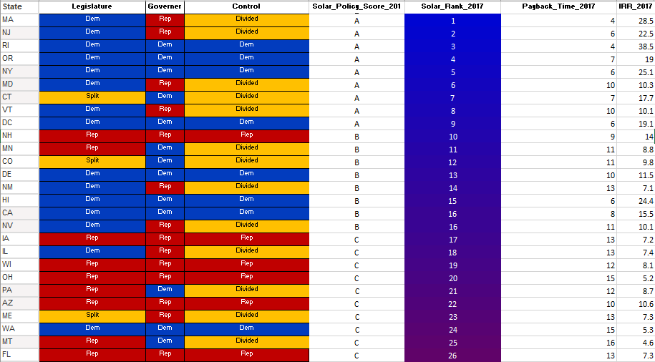
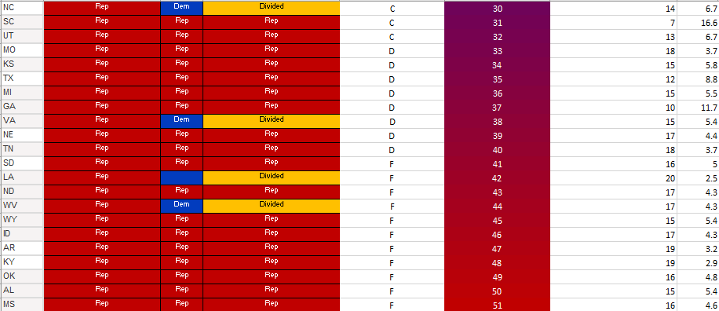
POLICY MATTERS!

Slide 24
FURTHER POTENTIAL STEPS
Explore how geography affects the model. For example construction costs differ by region, I did not account for this. Would focusing on each state separately yield better model?
I don’t model future changes in energy consumption, should I?
Time Series decomposition needs a lot more work.
Completely different angle – predict the growth of solar industry
Completely different angle – model relationship with ownership of electric vehicles
What about DoItYourself solar systems – how does one model costs there?

Slide 25
PRINT AND ELECTRONIC SOURCES Cited
NASA USA Insolation Rates - https://catalog.data.gov/dataset/nrel-gis-data-continental-united-states-photovoltaic-low-resolution
Berkeley Lab’s Tracking the Sun report series is dedicated to summarizing installed prices and other trends among grid-connected, distributed solar photovoltaic (PV) systems in the United States https://emp.lbl.gov/tracking-the-sun/
U.S. Energy Information Administration – electric rates by state https://www.eia.gov/electricity/data/state/
U.S. Cencus construction price index https://www.census.gov/construction/cpi/
State legislature composition http://www.ncsl.org/research/about-state-legislatures/partisan-composition.aspx
Electric vehicles stats https://www.afdc.energy.gov/data/ http://evadoption.com/ev-market-share/ev-market-share-state/
Microsoft BING Mapping API https://msdn.microsoft.com/en-us/library/dd877180.aspx
https://www.solarpowerrocks.com/infographics/solar-infographic-state-solar-investment-returns/

Slide 26
ACKNOWLEDGEMENTS
To Ann and Mike for their tireless help with the homeworks and final project assignments.
To Devin for putting up with my questions and interruptions.
To my family for encouraging me to finish the class
To my cats for providing emotional support
To the staff at Harvest Solar Power for building my system and for helping to find some of the data sets for this project.
To everyone who joined me on this data science journey!

